Slide 1


CUCKOO INDEXING
A secondary indexing Method

Slide 2
CONTENT
What is it?
Result
Technical Challenges
Problem
Objectives
Conclusion
Methodology
Reference

Slide 3
CUCKOO INDEXING
It is a secondary index.The main idea of cuckoo indexing is faster execution of queries.
Cuckoo filters use the idea of fingerprint,which is extracted from a hash function. Then, we extract primary and secondary bucket indices
Using these indices, we store fp in these buckets, implement collision handling , scan rate optimization and block bitmap

Slide 4
OBJECTIVE
The goal was to design a secondary index structure that minimizes scan rates and reduces data access costs while preserving accuracy, thus providing an efficient solution for modern data warehousing
In this B.Tech Mini Project, I explore the concept of Cuckoo Indexing and implement it using Python and PostgreSQL. First, I studied and analyzed the paper ”Cuckoo Index: A Lightweight Secondary Index Structure”, diving deep into concepts like fingerprints, scan rate optimization, collision handling, and block bitmaps. Upon completion of the theoretical study, I implemented Cuckoo Indexing practically using PostgreSQL and Python, initially testing it on a dummy dataset and later applying it to the l orderkey column of the lineitem table (TPC-H benchmark).

Slide 5

METHODOLOGY
Cuckoo filter(without merge bitmaps)
Cuckoo filter(with union)
Slot Mapping
Scan Rate
Block Bitmaps

Slide 6
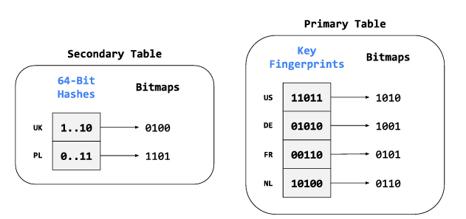
METHODOLOGY
First(without union)-main3-2 slots
Implemented simple bitmap approach, where each bucket had 2 slots
With each key, I would extract its fingerprint . From the fingerprint, I would fetch 2 bucket indices: primary and secondary
See which bucket had an empty slot. First ,primary bucket checked. If both slots full, then secondary

Slide 7
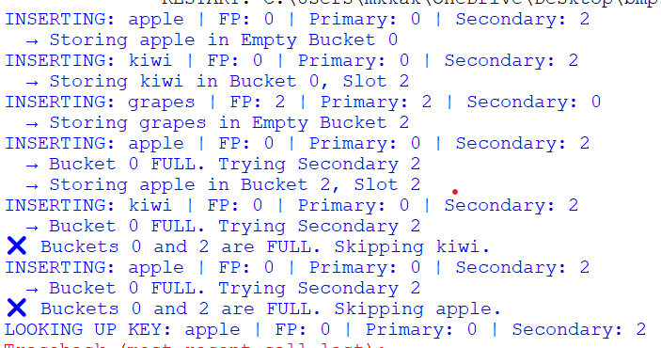
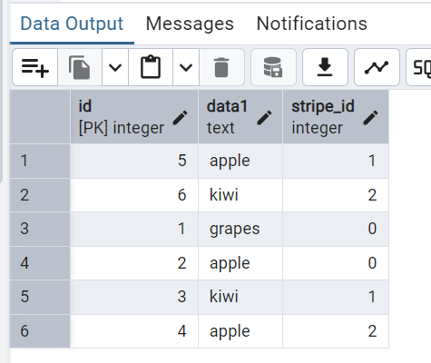
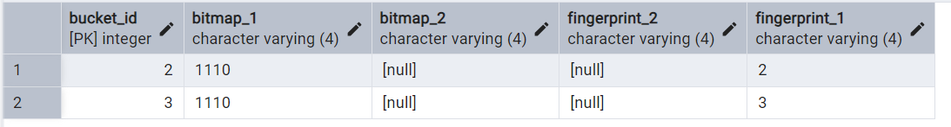

Slide 8
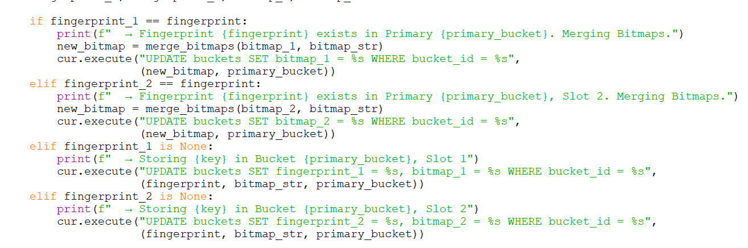
METHODOLOGY
Second(with union)-main4-2 slots
Implemented simple bitmap approach, where each bucket had 2 slots
With each key, I would extract its fingerprint
See which bucket had an empty slot. First ,primary bucket checked. If both slots full, then secondary
if key already present, then merge bitmaps

Slide 9
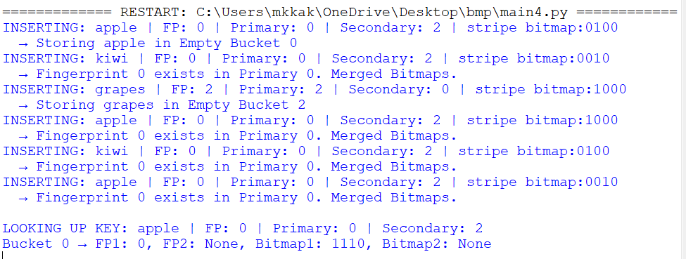
OUTPUT

Slide 10
Third-Slot mapping(main6)
Introduced slots
Stores the fingerprint is in which bucket at what slot.
Then, when we search, we directly go to the bucket at slot index

Slide 11
METHODOLOGY
Calculated optimal bits for each bucket
Introduced scan rate optimization- calculated the no. of bits per bucket required to prevent collisions. Thus, I first ,on a preliminary stage calculated the no. of fp per bucket. Then, I applied the algorithm provided in the paper to calculate the no. of fp per bucket, which i stored in an array. Then, every time i wanted the optimal bits per bucket, I fetched it from this array.
(Main15)
Done to avoid collsions
Fourth-scan rate
Stored in an array .(that this bucket requires this many bits)
for every fp,Fetched optimal bits when fp had to be stored in bucket, and inserted into available bucket
if fp already exist union the bitmap. If primary bucket full, then check secondary

Slide 12
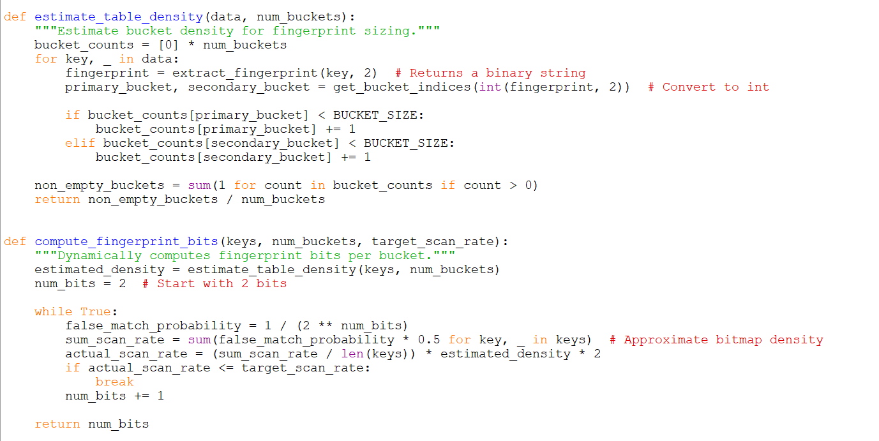
SCAN RATE

Slide 13
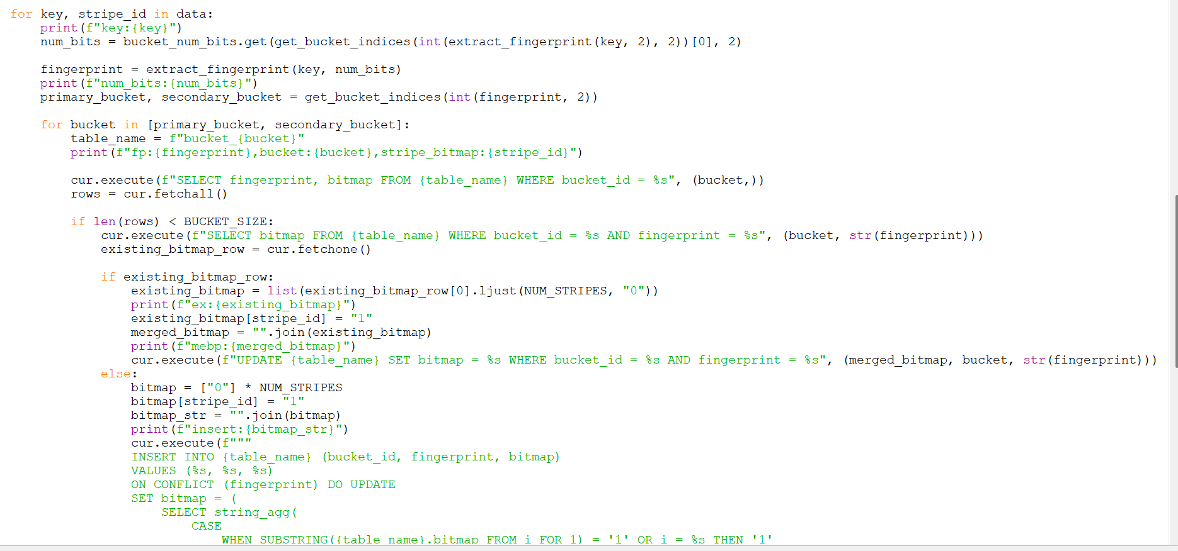
HOW OPTIMAL SIZE FOR FP IS FETCHED AND UNION IF FP ALREADY PRESENT

Slide 14
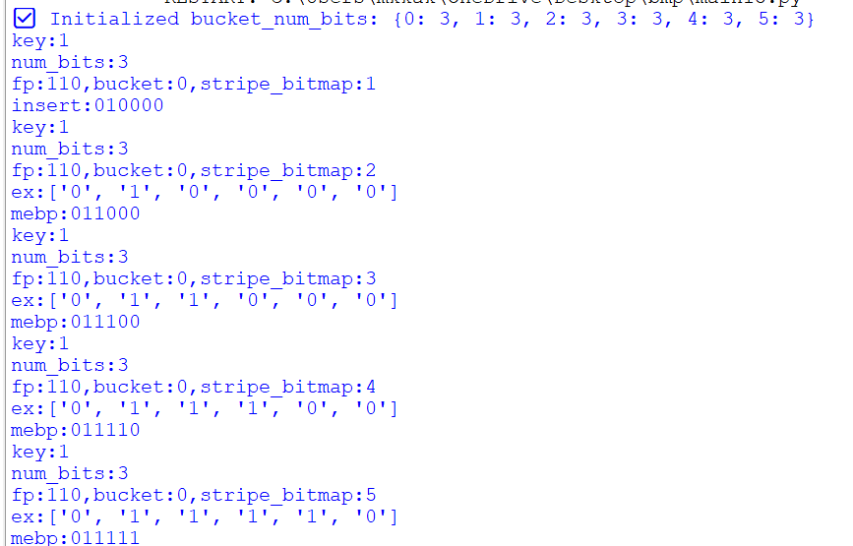
OUTPUT:

Slide 15
METHODOLOGY
Fourth-scan rate
REPEATED FOR 100 ROWS OF L_ORDERKEY COLUMN IN LINEITEM TABLE AND THEN, WITH 10,000 ROWS
TARGET SCAN RATE=0.0000001(10,000 ROWS)(MAIN19)
TRIED WITH 0.0001 SCAN RATE,BUT THERE WERE FINGERPRINT COLLISIONS
CORRECTLY WITH 0.0000001 SCAN RATE(16 FP BIT SIZE)(MAIN19)
USED MORE BUCKETS AND BUCKET SIZE:
NUM_BUCKETS = 64
BUCKET_SIZE = 50
NUM_STRIPES = 32
TARGET_SCAN_RATE = 0.0000001

Slide 16
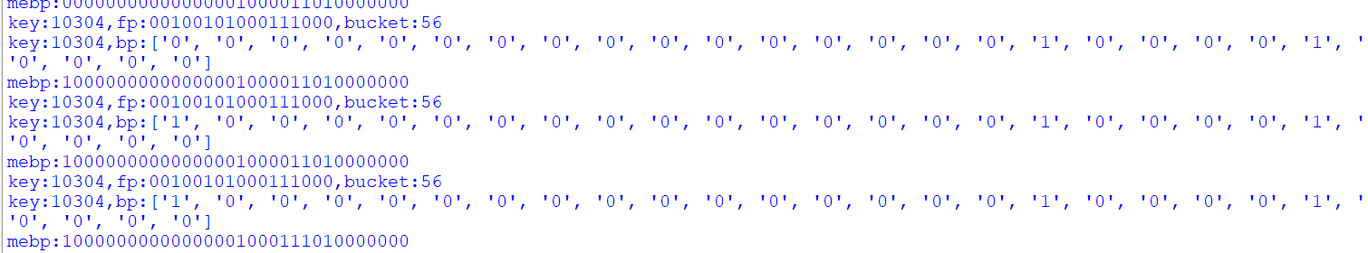
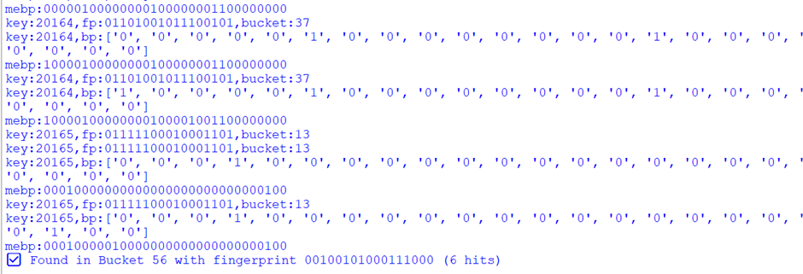

Slide 17
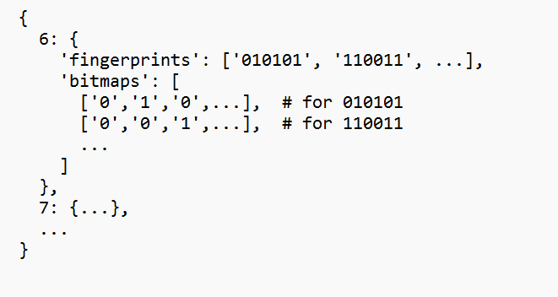
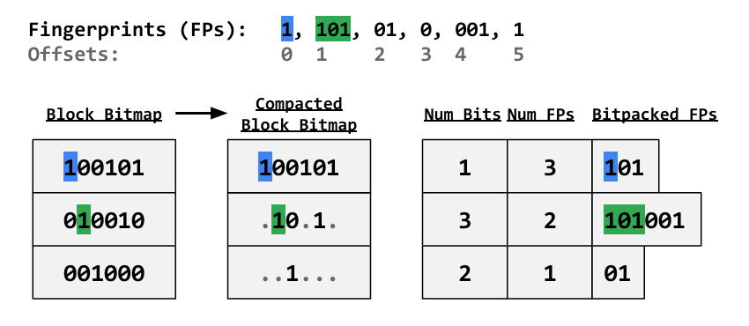
METHODOLOGY
Created ci_index table in psql with three columns-bit_width, fingerprint and bitmap and blcok bitmap. It stores the fp and corresponding stripe bitmap for each fp
block bitmap(main24)
see which block bitmap has set bit for slot_idx. Calculate idx_in_block for fp using the block bitmap and rank algo
Extract fp in idx_in_block
Offset the slot_idx

Slide 18
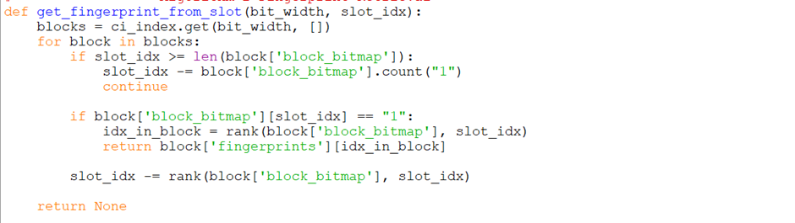
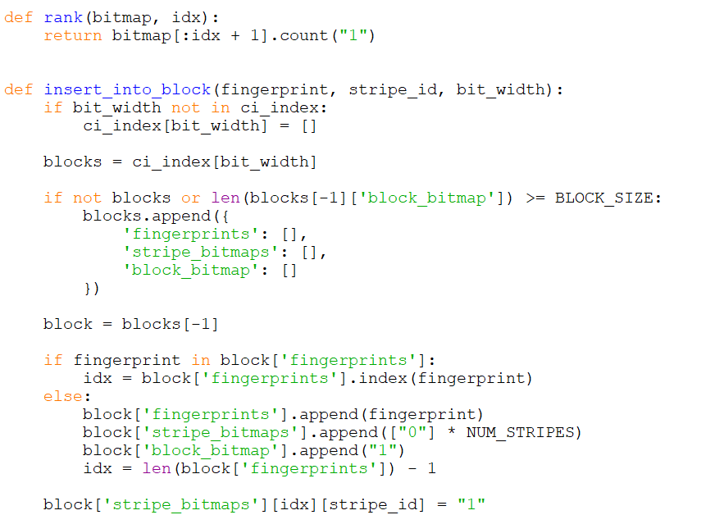
Returns the fingerprint stored in block with given slot_id
The rank function and insert into block function

Slide 19
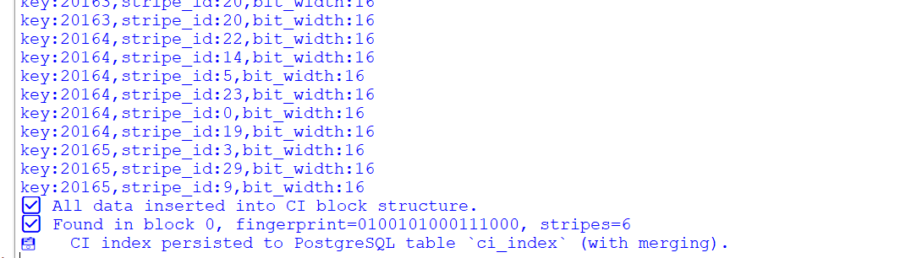
OUTPUT

Slide 20
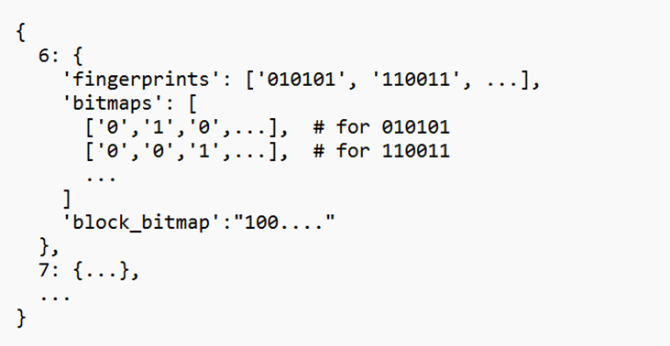
ROUGH SKETCH:
Why 16 Bits?
Fingerprint Space: 2^16 = 65,536 unique values
Dataset Size: ~10,000–20,000 keys
Hashing Quality: SHA-256 ensures uniform distribution
Low Collision Risk: Probability of collision is negligible at this scale

Slide 21
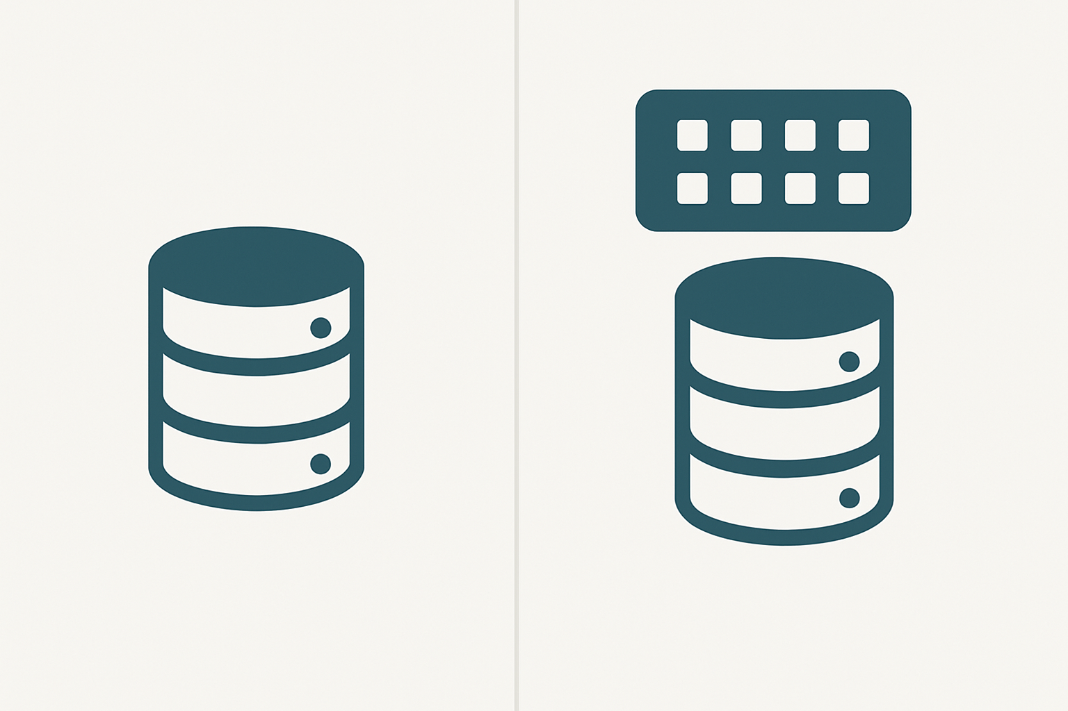
DATABASE
DATABSE WITH CUCKOO

Slide 22
EXPERIMENTAL SETUP
HARDWARE:
LAPTOP-16GB RAM
SOFTWARE
PYTHON 3.13.1
POSTGRESQL
DATASET
TPC-H TABLES
QUERYSET
STANDARD 19 QUERIES

Slide 23
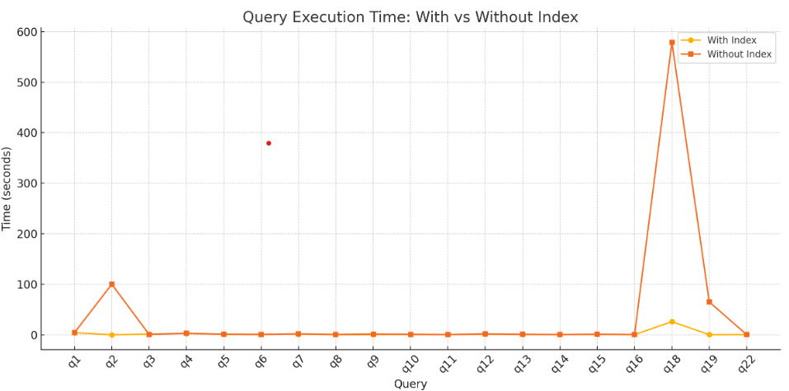
EXPERIMENTAL SETUP
EVALUATION PARAMETERS
QET(GRAPH)(AVG TIME)

Slide 24
RESULT
AVG TIME WITHOUT INDEXING: 40 SECS
AVG TIME WITH INDEXING: 2.27 SECS
IN SOME QUERIES, WITH INDEXING TIME EXCEEDS WITHOUT INDEXING BECAUSE OF THE PRE-COMPUTATION OF FINGERPRINT DONE IN CUCKOO INDEXING

Slide 25
TECHNICAL CHALLENGES
Deciding the no. of buckets for 10,000 rows
implementing scan rate optimization(without collision handling)

Slide 26
LIMITATIONS
Implementing a nested bucket tables- But how to index it?
For dynamic queries

Slide 27
CONCLUSION
Block bitmaps improve the execution of queries
First,I understood the paper before implementing it using PostgreSQL and python. Then, I experimented it with Cuckoo filters,scan rate optimization and block bitmaps
Analysing the result,I found out that block bitmaps take less time than directly executing the queries on the database.

Slide 28
REFERENCES
PRINCIPLES OF DISTRIBUTED DATABASE SYSTEMS- M. TAMER ÖZSU ,PATRICK VALDURIEZ
CUCKOO INDEX: A LIGHTWEIGHT SECONDARY INDEX STRUCTURE - ANDREAS KIPF, DAMIAN CHROMEJKO, ALEXANDER HALL, PETER BONCZ, DAVID G. ANDERSEN

Slide 29
Thank You

